Slide 1
Lecture 31
Deadlocks
Dr. Ehtesham Zahoor
National University of
Computer & Emerging Sciences

Slide 2


Deadlocks in the Computer World
Word
Processor
has exclusive access of
needs
Web
browser
needs
has exclusive access of
Operating Systems

Slide 3
Deadlock Characterization
Deadlock can arise if four conditions hold simultaneously.
Mutual exclusion: only one process at a time can use a resource.
Hold and wait: a process holding at least one resource is waiting to acquire additional resources held by other processes.
No preemption: a resource can be released only voluntarily by the process holding it, after that process has completed its task.
Circular wait: there exists a set {P₀, P₁, …, P₀} of waiting processes such that P₀ is waiting for a resource that is held by P₁, P₁ is waiting for a resource that is held by P₂, …, P_{n–1} is waiting for a resource that is held by
P_{n}, and P₀ is waiting for a resource that is held by P₀.

Slide 4

Example of a Resource Allocation Graph

Slide 5
Methods for Handling Deadlocks
Ensure that the system will never enter a deadlock state. Deadlock Prevention and avoidance
Allow the system to enter a deadlock state and then recover. Deadlock Detection
Ignore the problem and pretend that deadlocks never occur in the system; used by most operating systems, including UNIX.

Slide 6
Deadlock Avoidance
Requires that the system has some additional a priori information available.
Each process declare the maximum number of resources of each type that it may need.
The deadlock-avoidance algorithm dynamically examines the resource-allocation state to ensure that there can never be a circular-wait condition.
Resource-allocation state is defined by the number of available and allocated resources, and the maximum demands of the processes.

Slide 7
Safe State
If a process requests a resource, system must decide if immediate allocation leaves the system in a safe state.
System is in safe state if there exists a safe sequence of all processes.
Sequence <P1, P2, …, Pn> is safe if for each Pi, the resources that Pi can still request can be satisfied by currently available resources + resources held by all the Pj, with j<i.
  If P_{i} resource needs are not immediately available, then P_{i} can wait until all P_{j} have finished.
  When P_{j} is finished, P_{i} can obtain needed resources, execute, return allocated resources, and terminate.
  When P_{i} terminates, P_{i+1} can obtain its needed resources, and so on.

Slide 8
Basic Facts
If a system is in safe state ⇒ no deadlocks.
If a system is in unsafe state ⇒ possibility of deadlock.
Avoidance ⇒ ensure that a system will never enter an unsafe state.

Slide 9

Safe, Unsafe , Deadlock State

Slide 10
Resource-Allocation Graph Algorithm
Claim edge P_{i} → R_{j} indicated that process P_{j} may request resource R_{j}; represented by a dashed line.
Claim edge converts to request edge when a process requests a resource.
When a resource is released by a process, assignment edge reconverts to a claim edge.
Resources must be claimed a priori in the system.

Slide 11

Resource-Allocation Graph For Deadlock Avoidance

Slide 12

Unsafe State In Resource-Allocation Graph

Slide 13
Banker’s Algorithm
Multiple instances.
Each process must a priori claim maximum use.
When a process requests a resource it may have to wait.
When a process gets all its resources it must return them in a finite amount of time.

Slide 14
Resources
For the Banker's algorithm to work, it needs to know three things:
  How much of each resource each process could possibly request
  How much of each resource each process is currently holding
  How much of each resource the system has available

Slide 15
Data Structures for the Banker’s Algorithm
Let n = number of processes, and m = number of resources types.
Available: Vector of length m. If available [j] = k, there are k instances of resource type R_{j} available.
Max: n x m matrix. If Max [i,j] = k, then process P_{i} may request at most k instances of resource type R_{j}.
Allocation: n x m matrix. If Allocation[i,j] = k then P_{i} is currently allocated k instances of R_{j.}
Need: n x m matrix. If Need[i,j] = k, then P_{i} may need k more instances of R_{j} to complete its task.
    Need [i,j] = Max[i,j] – Allocation [i,j].

Slide 16
Example
Assuming that the system distinguishes between four types of resources, (A, B, C and D)
Consider the following distribution

Slide 17
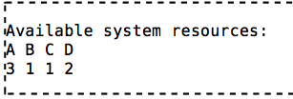
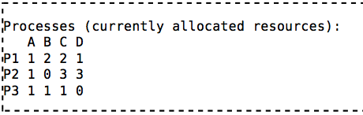
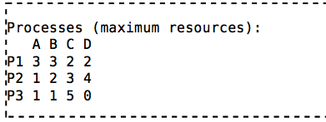
Example

Slide 18
Is a given state safe?
For the algorithm, a state (as in the example) is safe if it is possible for all processes to finish executing (terminate)
The algorithm tries to find a sequence that would allow each process to acquire its maximum resources and then terminate.
Any state where no such set exists is an unsafe state.

Slide 19
Banker Algorithm
P - set of processes
Mp - maximal requirement of resources for process p
Cp - current resources allocation process p
A - currently available resources
while (P != ∅) {
found = FALSE;
foreach (p ∈ P) {
if (Mp − Cp ≤ A) {
/* p can obtain all it needs.
*/ /* assume it does so, terminates, and
*/ /* releases what it already has. */
A = A + Cp ;
P = P − {p};
found = TRUE;
}
}
if (! found) return FAIL; }
return OK;

Slide 20
Example – State is Safe?

Slide 21
Example – State is Safe?
We need to show that it is possible for each process to acquire its maximum resources and then terminate.

Slide 22
Example – State is Safe?
  P1 acquires 2 A, 1 B and 1 D more resources, achieving its maximum The system now still has 1 A, no B, 1 C and 1 D resource available
  P1 terminates, returning 3 A, 3 B, 2 C and 2 D resources to the system The system now has 4 A, 3 B, 3 C and 3 D resources available

Slide 23
Example – State is Safe?
  P2 acquires 2 B and 1 D extra resources, then terminates, returning all its resources
  The system now has 5 A, 3 B, 6 C and 6 D resources
  P3 acquires 4 C resources and terminates
  The system now has all resources: 6 A, 4 B, 7 C and 6 D

Slide 24
Example – State is Safe?
  Because all processes were able to terminate, this state is safe
  For an example of an unsafe state, consider what would happen if process 2 was holding 1 more unit of resource B at the beginning.

Slide 25
How requests are handled?
When the system receives a request for resources, it runs the Banker's algorithm to determine if it is safe to grant the request.

Slide 26
How requests are handled?
Can the request be granted?
If not, the request is impossible and must either be denied or put on a waiting list
Assume that the request is granted
Is the new state safe?
  If so grant the request
  If not, either deny the request or put it on a waiting list

Slide 27
Example – Grant request?

Slide 28
Example – Grant request?
Assume process 3 requests 2 units of resource C.
  There is not enough of resource C available to grant the request
  The request is denied

Slide 29
Example – Grant request?
Process 3 requests 1 unit of resource C.
  There are enough resources
  Assume the request is granted
  The new state of the system would be:

Slide 30
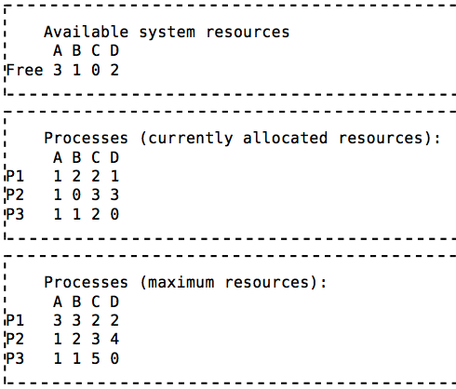
Example – Grant request?

Slide 31
Example – Grant request?
Determine if this new state is safe
  P1 can acquire 2 A, 1 B and 1 D resources and terminate
  Then, P2 can acquire 2 B and 1 D resources and terminate 3.
  P3 can acquire 3 C resources and terminate
  Therefore, this new state is safe
Since the new state is safe, grant the request

Slide 32
Deadlock Detection
Allow system to enter deadlock state
Detection algorithm
Recovery scheme

Slide 33
Single Instance of Each Resource Type
Maintain wait-for graph
  Nodes are processes.
  P_{i} → P_{j} if P_{i} is waiting for P_{j}.
Periodically invoke an algorithm that searches for a cycle in the graph.
An algorithm to detect a cycle in a graph requires an order of n² operations, where n is the number of vertices in the graph.

Slide 34

Resource-Allocation Graph and Wait-for Graph
Resource-Allocation Graph
Corresponding wait-for graph

Slide 35
Depth-first searching
A depth-first search (DFS) explores a path all the way to a leaf before backtracking and exploring another path
For example, after searching A, then B, then D, the search backtracks and tries another path from B
Node are explored in the order A B D E H L M N I O P C F G J K Q
N will be found before J
A
B
C
D
E
F
G
H
I
J
K
L
M
N
O
P
Q

Slide 36

Deadlock Detection
Is there a Deadlock?
Use any cycle detection algorithm
If there’s a cycle there’s a deadlock

Slide 37
Depth First Search
Take each node as root, of what it hopes is a tree
Left to Right, Top to Bottom
R, A, B, C, S, D, T, E, F, U, V, W, G
For each Node
  For each outgoing edge
    Keep an empty list L
    Follow the path and keep adding the nodes to the List L
    If the node already exists in the List we have a cycle
    Continue till dead end

Slide 38
Depth First Search
R, A, S
A, S
B, T, E, V, G, U, D, S
B, T, E, V, G, U, D, T

Slide 39
Several Instances of a Resource Type
When multiple copies of some of the resources exist, a different approach is needed to detect deadlocks.

Slide 40
Data structures
Existence: A vector of length m indicates the total number of existing resources of each type.
Available: A vector of length m indicates the number of available resources of each type.
Allocation: An n x m matrix defines the number of resources of each type currently allocated to each process.
Request: An n x m matrix indicates the current request of each process. If Request [i_{j}] = k, then process P_{i} is requesting k more instances of resource type. R_{j}.

Slide 41
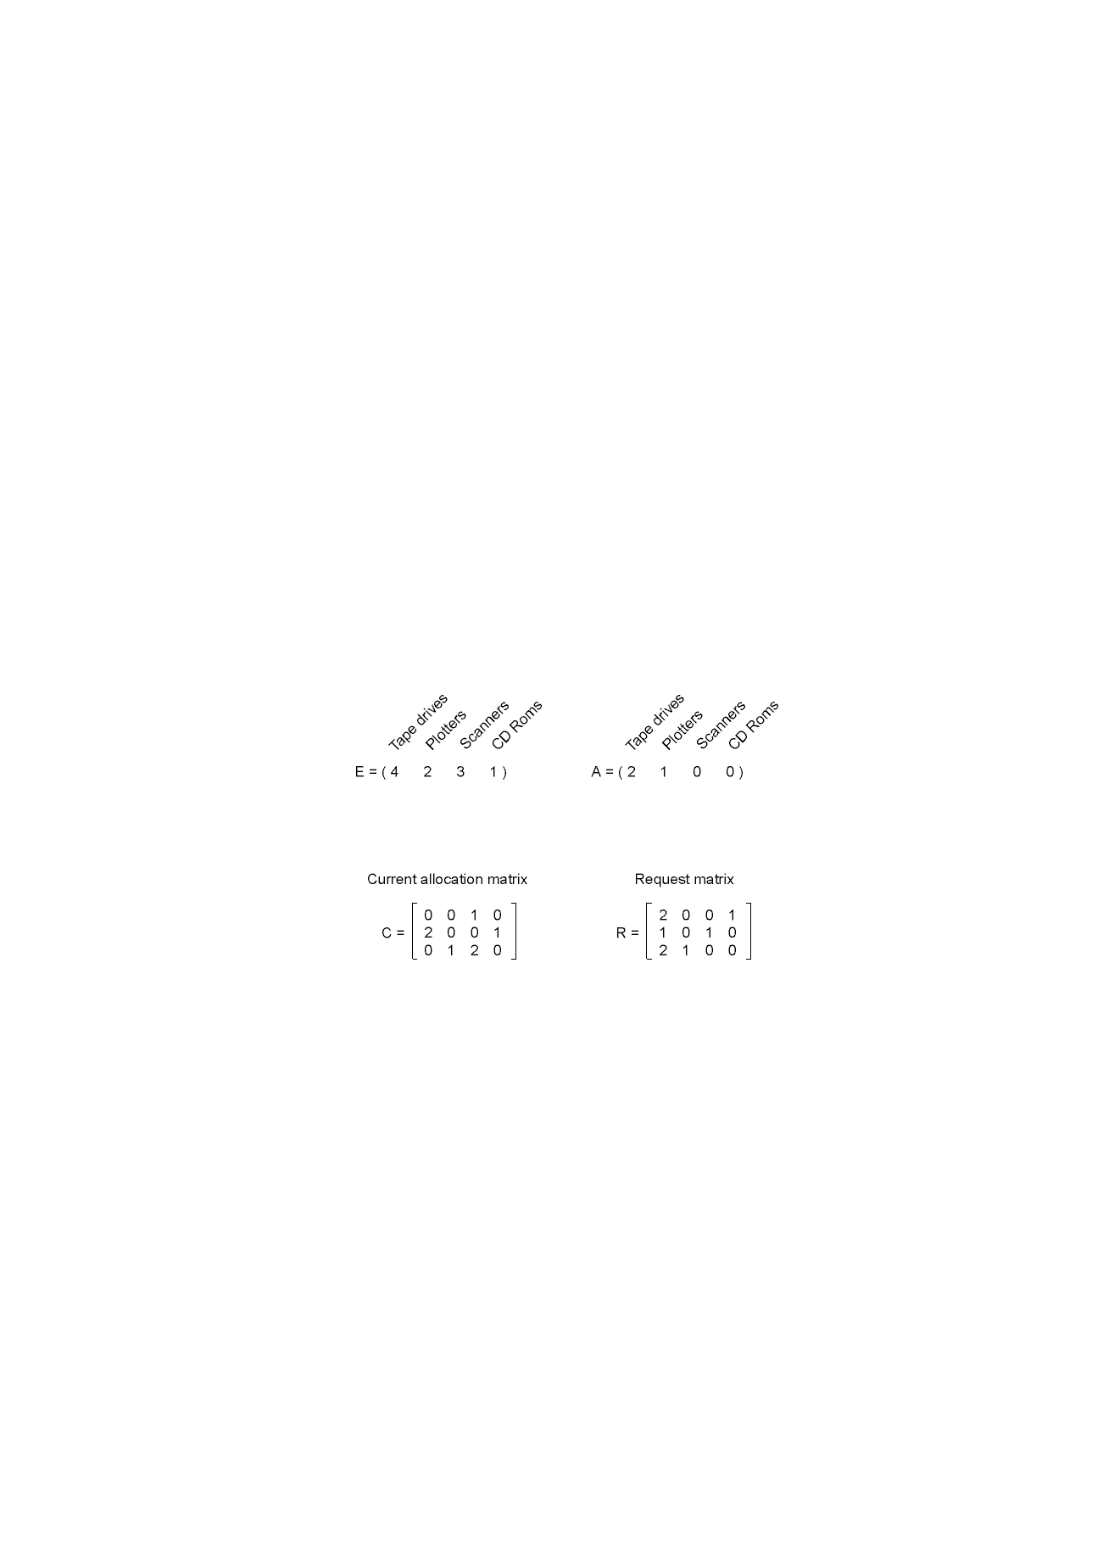
Example
Processes = 3; Resources = 4

Slide 42
Data structure
The deadlock detection algorithm is based on comparing vectors.
  A ≤ B on two vectors A and B to mean that each element of A is less than or equal to the corresponding element of B. Mathematically, A ≤ B holds iff Ai ≤Bi for1<i<m.

Slide 43
Algorithm
Each process is initially unmarked.
As the algorithm progresses, processes will be marked, indicating that they are able to complete and are not deadlocked.
When the algorithm terminates, any unmarked processes are deadlocked.

Slide 44
Algorithm
Look for an unmarked process, Pi, for which the i-th row of R is less than or equal to A.
If such a process is found, add the i-th row of C to A, mark the process, and go back to step 1.
If no such process exists, the algorithm terminates.

Slide 45
Example
Processes = 3; Resources = 4

Slide 46
Example
To run the deadlock detection algorithm, we look for a process whose resource request can be satisfied.
  The first one cannot be satisfied because there is no CD-ROM drive available.
  The second cannot be satisfied either, because there is no scanner free.

Slide 47
Example
Process 3 runs and eventually returns all its resources, giving A = (2 2 2 0)
At this point process 2 can run and return its resources, giving A = (4 2 2 1)
Now the remaining process can run. There is no deadlock in the system.

Slide 48
Example
Now consider a minor variation.
Suppose that process 2 needs a CD-ROM drive as well as the two tape drives and the plotter.
None of the requests can be satisfied, so the entire system is deadlocked.

Slide 49
Detection-Algorithm Usage
When, and how often, to invoke depends on:
  How often a deadlock is likely to occur?
  How many processes will need to be rolled back?
    one for each disjoint cycle
If detection algorithm is invoked arbitrarily, there may be many cycles in the resource graph and so we would not be able to tell which of the many deadlocked processes “caused” the deadlock.

Slide 50
Recovery from Deadlock: Process Termination
Abort all deadlocked processes.
Abort one process at a time until the deadlock cycle is eliminated.
In which order should we choose to abort?
  Priority of the process.
  How long process has computed, and how much longer to completion.
  Resources the process has used.
  Resources process needs to complete.
  How many processes will need to be terminated.
  Is process interactive or batch?

Slide 51
Recovery from Deadlock: Resource Preemption
Selecting a victim – minimize cost.
Rollback – return to some safe state, restart process for that state.
Starvation – same process may always be picked as victim, include number of rollback in cost factor.

Slide 52
Combined Approach to Deadlock Handling
Combine the three basic approaches
  prevention
  avoidance
  detection
allowing the use of the optimal approach for each of resources in the system.
Partition resources into hierarchically ordered classes.
Use most appropriate technique for handling deadlocks within each class.

Slide 53

Traffic Deadlock

